Slide 1

Deployment Project
HENRY GIORGI
Data Science Bootcamp

Slide 2
Goal
Automate the loan eligibility process.
Notes:
The project objective is to automate the loan eligibility process based on customer data provided as online application forms.
The data set contains socio-economic information of the applicants.
As goal of the project it is needed to create a ML model to predict the approval of loan applications.

Slide 3
Features
Loan: Amount and term
Income: Applicant and Coapplicant
Dependents
Education
Credit History
Property Area

Slide 4
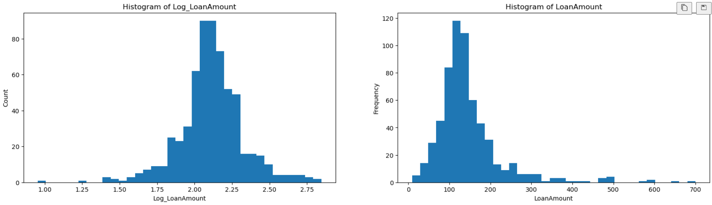
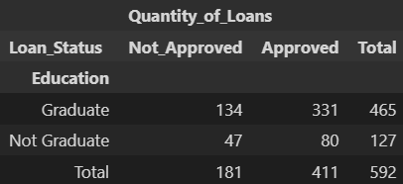
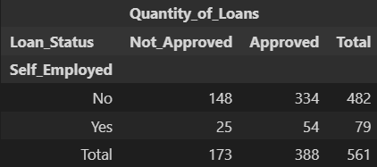
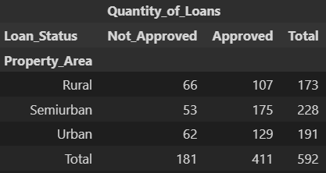
EDA
Higher education level
Self-employeed
Property area

Slide 5
Results
Model: Random Forest Classifier
Metric | Value
Accuracy | 0.723
Precision | 0.699
Recall | 0.658
F1 Score | 0.666
Hyperparams: Accuracy = 0.777

Slide 6
Challenges
Complications deploying API.

Slide 7
Future Goals
Implementing more ML models
Deeper analysis of hypothesis

Slide 8
Thank you

